Slide 1
Applying Model Based Design for Quad-Rotor Control System
Presenter: Sang-Ho Yoon
Senior Application Engineer

Slide 2
Today’s Agenda
Control System Design Challenge
Quad-Rotor Vehicle Modeling
Multi-domain physical modeling using Simscape
SimMechanics including CAD file import
Controller Design and Implementation
Design with Requirement
Controller Tuning
Code Generation
Team-Based Development with Simulink Projects
Software Engineering
Hybrid Simulink-UML Workflow
Questions and Answers
Notes:
Review agenda and timing.

Slide 3
Control System Design Challenge

Slide 4
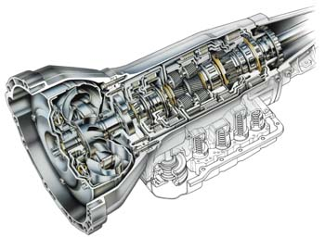
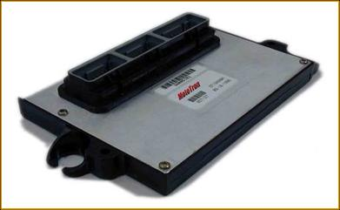
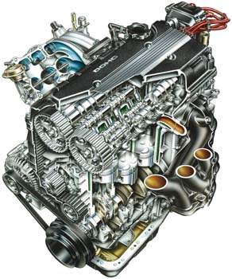
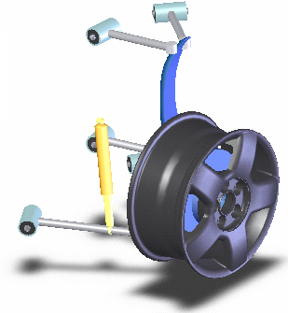
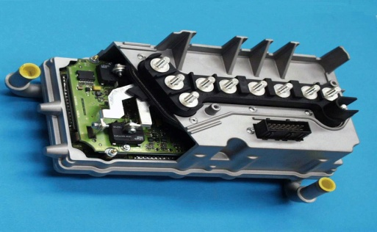
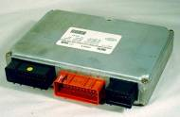
Control System Design Challenge
Actuators
System
Sensors
s1
s2
s3
Controller
Plant
Controller
Controller
Plant
Plant
Notes:
Key Message is ALL PLANTS HAVE CONTROL SYSTEMS
IF YOU ARE MODELING A PLANT,
YOU NEED TO MODEL CONTROL SYSTEM, TOO

Slide 5
Control System Design Challenge
Need to simulate plant and controller in one environment to optimize system-level performance.
Controls engineers and domain specialists need to work together to detect integration issues in simulation.
Actuators
System
Sensors
+
s1
s2
u
y
s3
Controller
Plant
Notes:
Key Message
Develop_Controller_And_Plant_In_One_Environment
http://www-internal.mathworks.com/wiki/index.php/Physical_Modeling_Tools_Key_Messages#Develop_Controller_And_Plant_In_One_Environment

Slide 6
Plant (Quad-Rotor Vehicle) Modeling

Slide 7
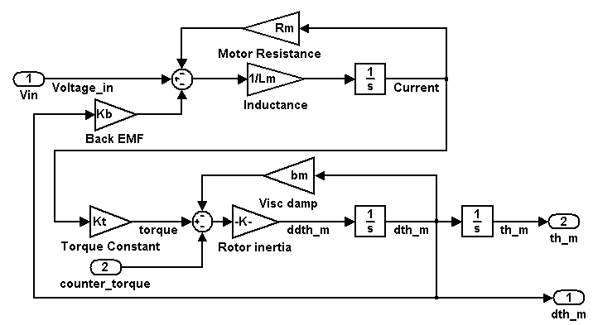
Electrical Systems in Equations
DC Motor
R
L
θ
K_{t},K_{e}
J,b
i
Notes:
Key Message
http://www-internal.mathworks.com/wiki/index.php/Physical_Modeling_Tools_Key_Messages#Saves_Deriving_and_Programming_Equations

Slide 8
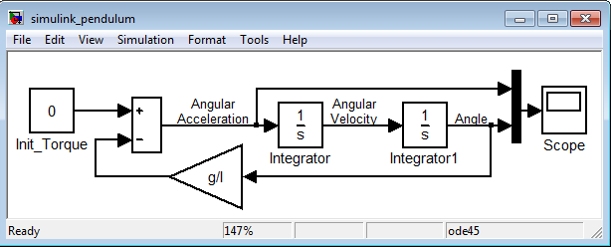
Mechanical Systems in Equations
y
Simple Pendulum
..
x
ΣT_{z} = Iθ₁
-mgl*sin(θ₁)= ml²θ₁
θ₁ = - sin(θ₁)
z
..
l
..
g
l
θ
1
mg
Notes:
Key Message
http://www-internal.mathworks.com/wiki/index.php/Physical_Modeling_Tools_Key_Messages#Saves_Deriving_and_Programming_Equations

Slide 9
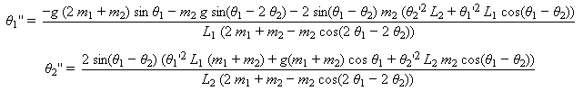
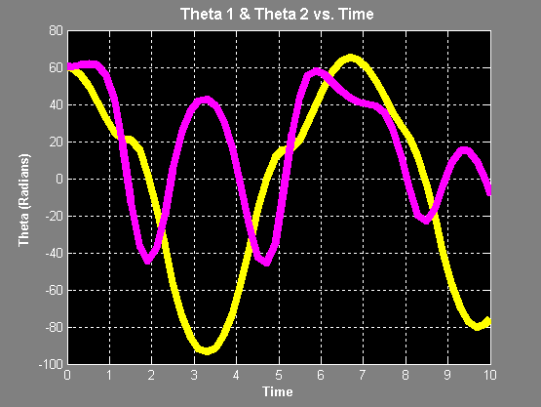
Mechanical Systems in Equations
y
x
z
θ
1
θ
m₁g
2
m₂g
Notes:
Key Message
http://www-internal.mathworks.com/wiki/index.php/Physical_Modeling_Tools_Key_Messages#Saves_Deriving_and_Programming_Equations

Slide 10
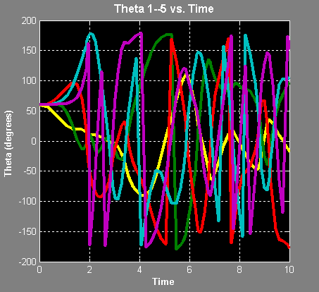
Mechanical Systems in Equations
y
θ
5
m₅g
x
θ
4
z
m₄g
θ
θ
3
1
θ
m₃g
2
m₁g
m₂g
Notes:
Key Message
http://www-internal.mathworks.com/wiki/index.php/Physical_Modeling_Tools_Key_Messages#Saves_Deriving_and_Programming_Equations

Slide 11
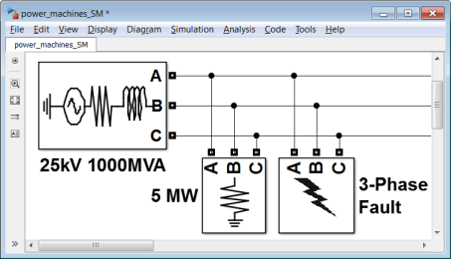
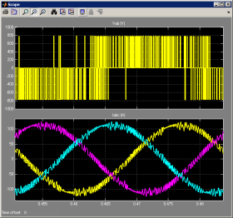
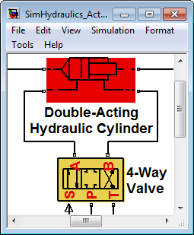
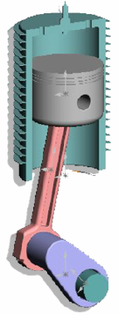
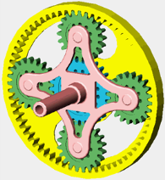
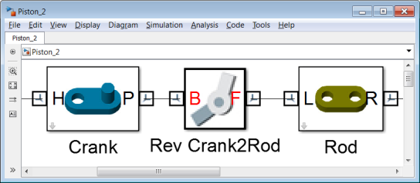
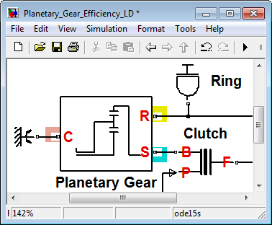
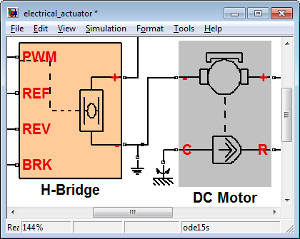
Physical Systems in Simulink
SimPowerSystems
SimMechanics
SimHydraulics
SimDriveline
SimElectronics
Simscape
Mechanical
Hydraulic
Electrical
Simscape
MATLAB, Simulink
SimPowerSystems
Thermal Liquid
Pneumatic
Magnetic
SimHydraulics
N
S
Custom Domains via Simscape Language
Multidomain physical systems
Electrical power systems
Fluid power and control
SimMechanics
SimDriveline
SimElectronics
Multibody mechanics (3-D)
Mechanical systems (1-D)
Electromechanical and electronic systems

Slide 12
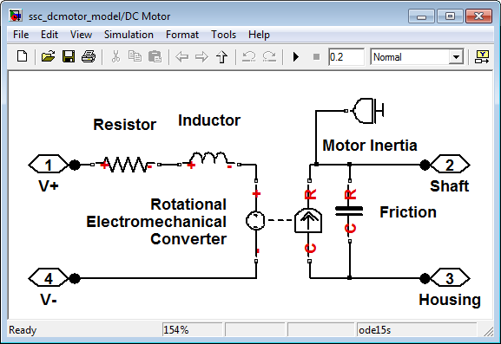
Electrical Systems in Simscape
DC Motor
Simscape model advantages:
Easier to read than equations
Quicker to create
More intuitive – easier to explain to other engineers
R
L
θ
K_{t},K_{e}
J,b
i
Notes:
Key Message
http://www-internal.mathworks.com/wiki/index.php/Physical_Modeling_Tools_Key_Messages#Saves_Deriving_and_Programming_Equations

Slide 13
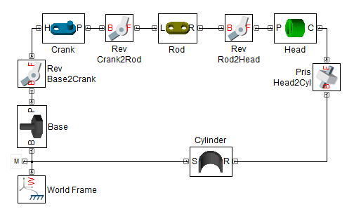
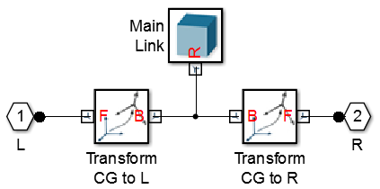
Modeling 3D Mechanical Systems
Build a model whose structure represents the system:
Parts (mass, inertia)
Coordinate systems
Joints and constraints
Save subsystems for reuse in other models
Parameterize model using MATLAB variables
Connect directly to Simscape and Simulink
Notes:
R2012a: Second Generation technology added to SimMechanics

Slide 14
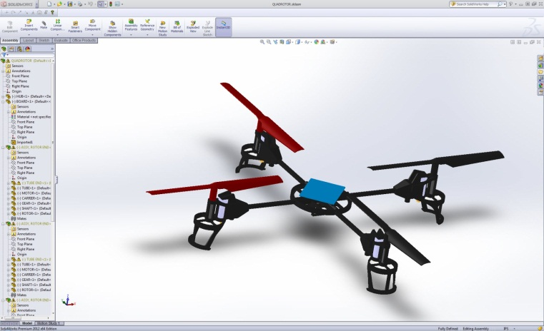
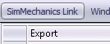
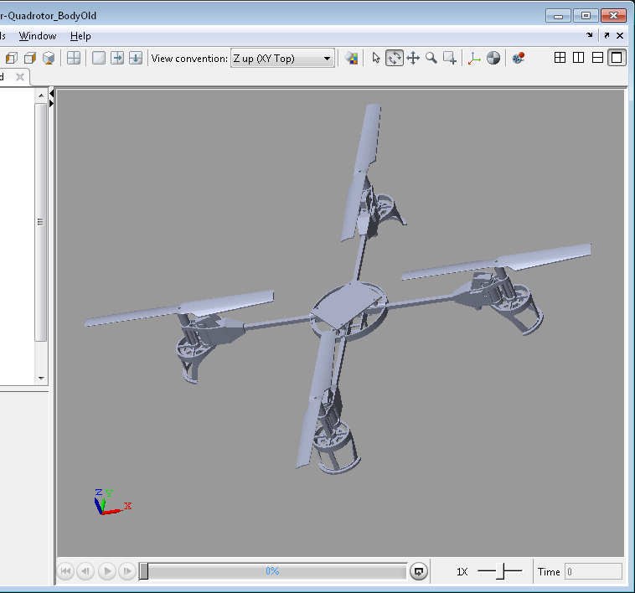
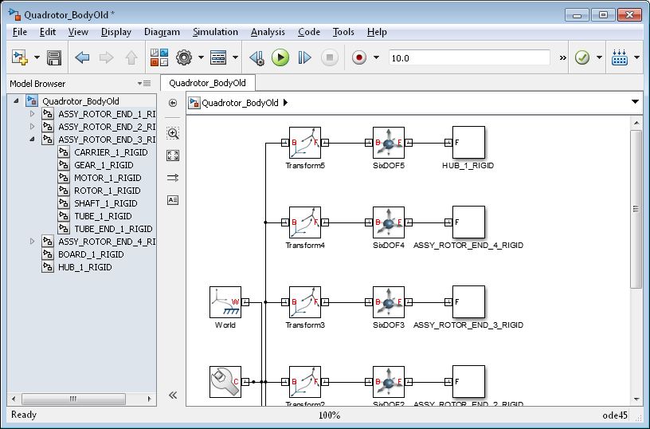
Import CAD Data Using SimMechanics Link
Automatically create SimMechanics models from a CAD assembly
Converts mass and inertia to rigid bodies
Converts mate definitions to joints
Creates STL files for use with SimMechanics visualization
Directly connects SolidWorks, ProEngineer and Inventor
Public API for other CAD tools
Free download from www.mathworks.com
Notes:
R2012b: Import from SolidWorks, ProEngineer, and Inventor supported (model update not supported yet)

Slide 15
Save Time
Plant
Specification
Fortran, C++
Plant
Model
Multidomain
Domain Knowledge
Programming Effort
Mechanical
MATLAB, Simulink
Domain Knowledge
Programming Effort
Hydraulic
Electronic
Physical Modeling
Domain Knowledge
Program Effort
Power Systems
Notes:
Key Message
http://www-internal.mathworks.com/wiki/index.php/Physical_Modeling_Tools_Key_Messages#Saves_Deriving_and_Programming_Equations
http://www-internal.mathworks.com/wiki/index.php/Physical_Modeling_Tools_Key_Messages#Reduces_Required_Domain_Knowledge
Our Solution The Physical Modeling tools contain extensive libraries of basic building blocks with domain knowledge built in, allowing users to create useful and accurate models even if they do not have extensive experience in the domain.
The Physical Modeling tools enable enable modeling and simulation of physical systems without deriving and programming equations, allowing users without strong mathematic or programming backgrounds to easily create accurate and intuitive models.

Slide 16

Modeling Quad-Rotor Vehicle
Provided SolidWorks model specifying the vehicle geometry

Slide 17
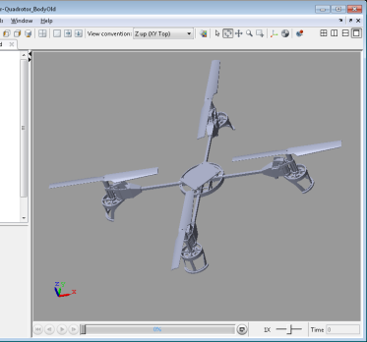
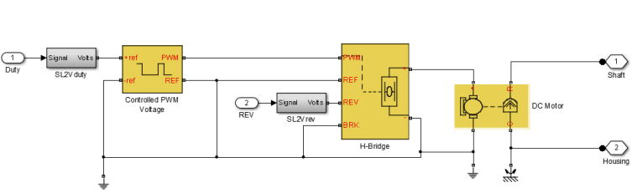

Modeling Quad-Rotor Vehicle
Provided SolidWorks model specifying the vehicle geometry
Create dynamic model using SimMechanics Link
Model motors in SimElectronics

Slide 18
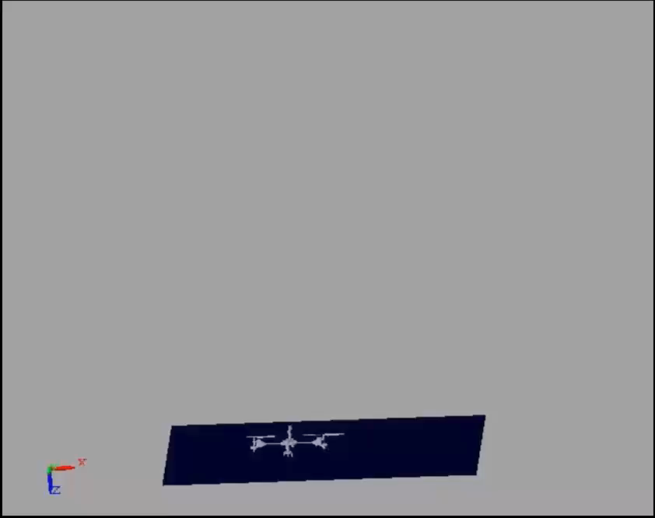

Modeling Quad-Rotor Vehicle
Use basic propeller equations to define forces and moments from props for initial design (Vehicle-ground interaction)
Add external force to represent collision with ground
Verify and improve design with vehicle and MathWorks tools

Slide 19
Controller Design with Requirement

Slide 20
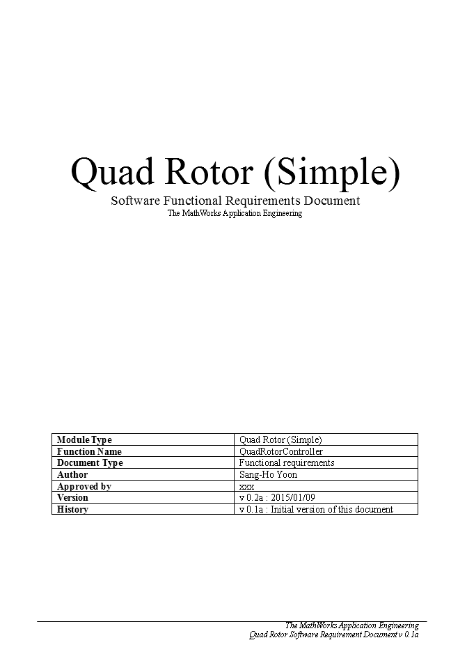
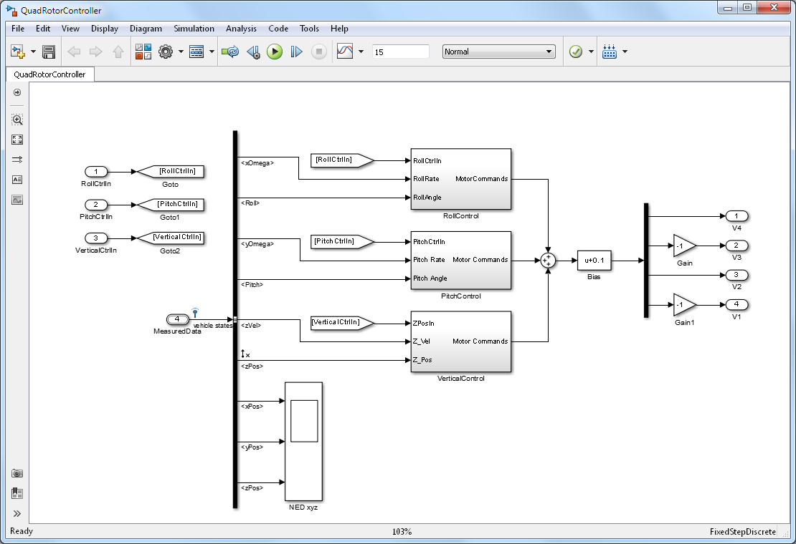
Quad-Rotor Control Algorithm Model
Functional Requirements
Simple TCU Model
Notes:
So we have created SBR algorithm model from the requirement!
>> sbr ( show the complete SBR algorithm model)
Do simple testing with constant blocks as inputs and display as output or
>>sbr_testHarness_simple

Slide 21
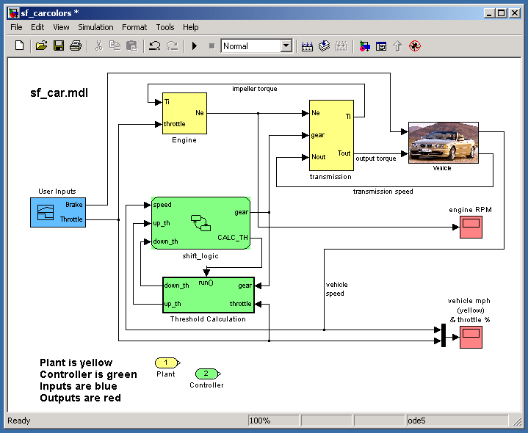
Modeling with Simulink
Requirements
Requirements
Create executable specifications
Design with simulation
Advantages:
Eliminate ambiguity
Facilitate team communication and component-based modeling
Analyze and improve requirements and design through simulation
Test system performance before building physical prototypes
Automate document generation
Design
Environment
Physical Components
Algorithms
Hand- Generate
Generate
Generate
Digital Electronics
Embedded Software
VHDL, Verilog
C, C++
FPGA
ASIC
MCU
DSP
Integration
Implement

Slide 22
Traceability
Functional Requirements
Design
Environment
Physical Components
Tracing Requirements⬄Model Simulink® Verification and Validation™
Tracing Model⬄Source Code Embedded Coder™
Tracing Requirements⬄Source Code Simulink Verification and Validation
Algorithms
Hand- Generate
Generate
Generate
Digital Electronics
Embedded Software
VHDL, Verilog
C, C++
FPGA
ASIC
MCU
DSP
Integration
Implement
Notes:
The left side of the diagram represents the design process that goes from high level requirements, and design, elaboration and implementation. All the way to deployment on the target. (click)
Traditionally, the majority of the verification and validation effort happens at the SW and SW/HW integration phase. (click)
What we are going to focus on today are methods for early verification and validation that allow you to shift a portion of your V&V effort earlier in the development and allow you to find and fix problems earlier. These early V&V methods are enabled through the use of MBD and I hope that after this sess

Slide 23
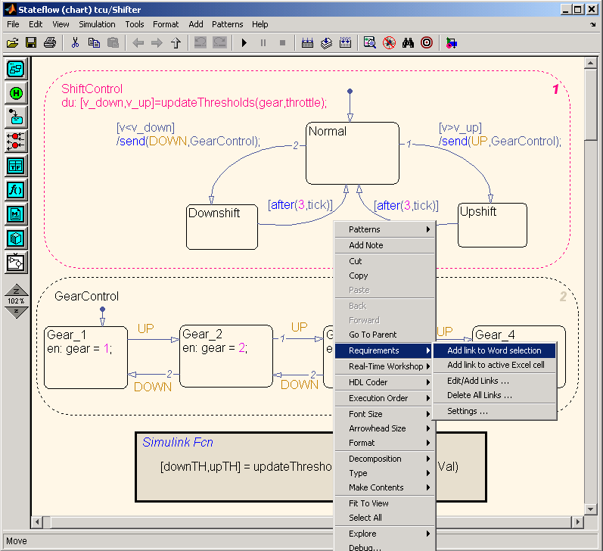
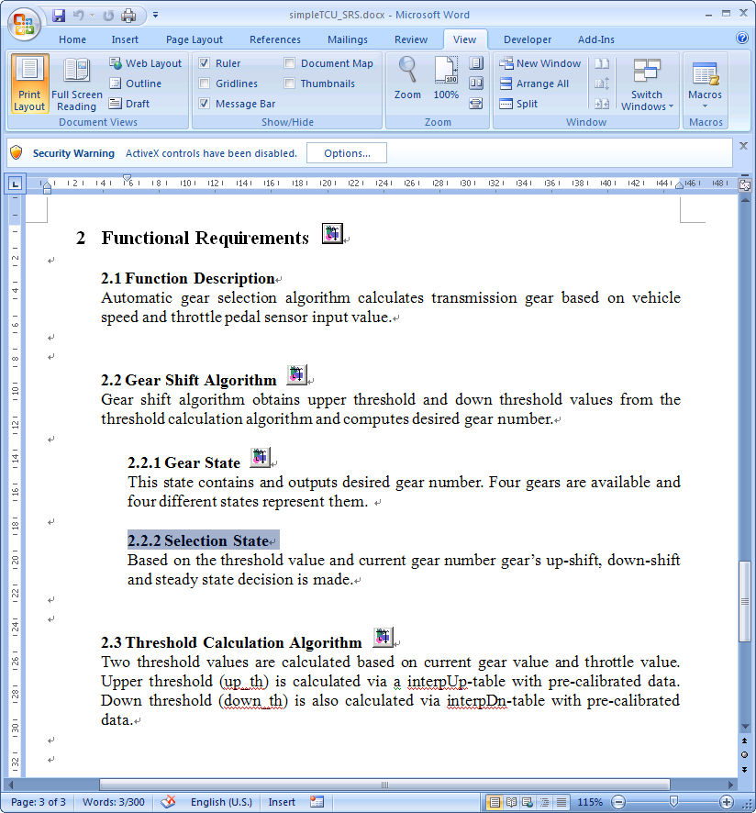
Tracing Requirements⬄Model Simulink Verification and Validation
Creating links between textual documents and model objects
Notes:
Suggestion for the presenter: Highlight the key features mentioned on the slide and then talk about the benefits of requirements linking – why is this important for the customer.
Typically requirements are scattered around in different documents, whether it is a managed environment, or not. Simulink and Stateflow models are used in conjunction with these predominantly textual documents to describe the details of the design. This situation raises many challenges – models and textual documents can get out of sync, it is difficult to navigate to the right requirement, especially if there are multiple versions of it – whether it is to review the latest revision, or to write a requirement.
To address these problems Simulink Verification and Validation provides an infrastructure that allows you to link a particular document paragraph to any block, state, or transition in the model. Typically this capability is used to assign high level requirements to subsystems, or low level requirements to specific implementation details, or even component tests in Simulink.
The supported format for textual documents are… (list)
The requirements linking capability has several features that can help you review traceability between the model and the text and if RTW-EC is used for code generation, linked textual information can be propagated to the generated code in form of code comments.

Slide 24
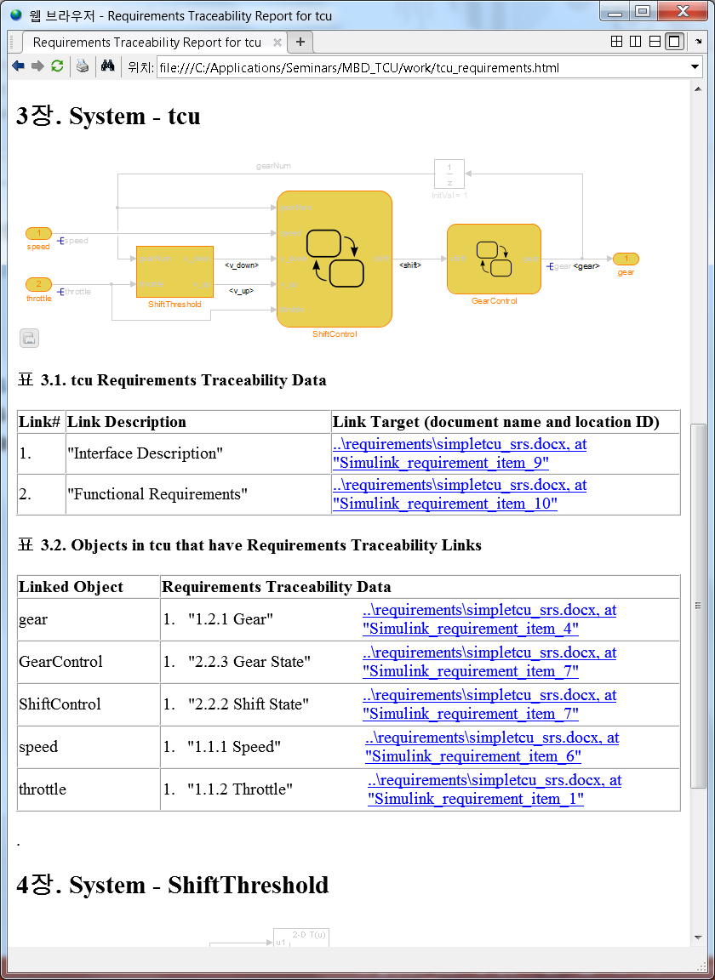
Requirements Traceability – Report Simulink Verification and Validation
Requirements Report provides screenshots of the model and lists all the associated requirements

Slide 25
Controller Tuning

Slide 26
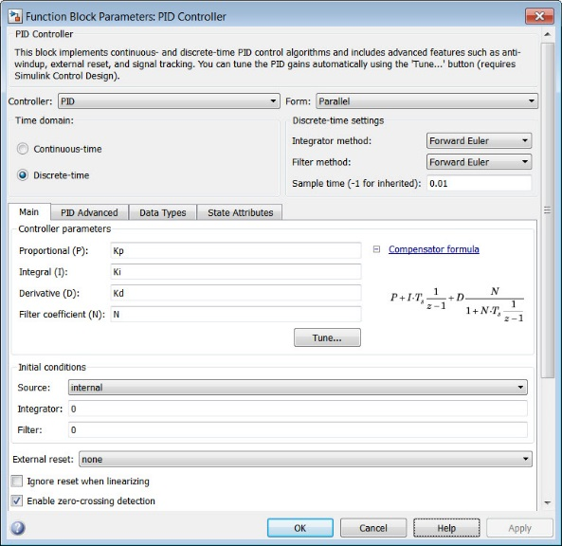
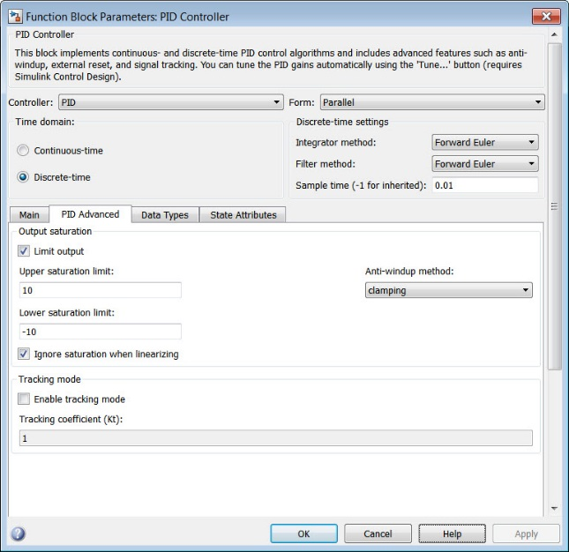
Simulink PID Controller Blocks
I, P, PD, PI, PID with approximate derivative
Parallel and ideal forms
Output saturation limits
Integrator anti-windup
Tracking mode for bumpless transfer

Slide 27
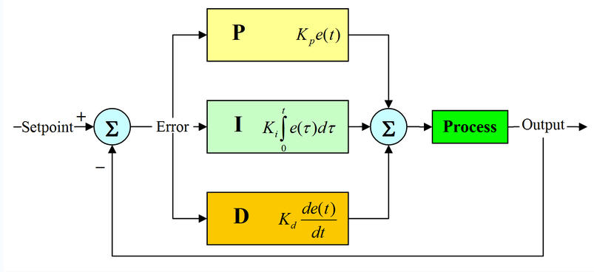
Tuning Challenges
Finding gains values to meet response time and overshoot (phase margin) specifications
Manual tuning is purely trial and error process, time consuming and non-systematic. It may not produce optimal design and can lead to dangerous conditions
Rule-based tuning requires a lot of work, or simply cannot be applied (open-loop unstable systems). It cannot be fine tuned
?
?
?

Slide 28
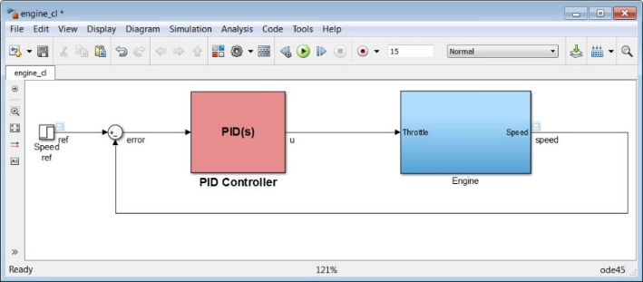
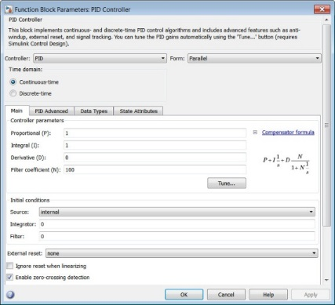
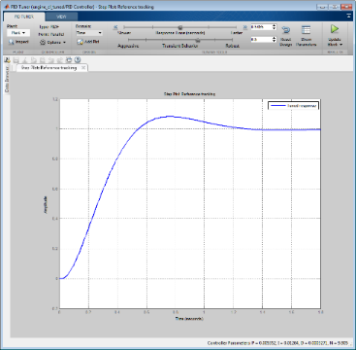
Solution: PID Tuner
Automatically finds gain values to meet specifications
Provides additional fine-tuning capability with simple sliders
Supports all types of plants
Requires Simulink Control Design
Notes:
Mention that tuner linearizes the model at a specific operating point

Slide 29
Code Generation

Slide 30
Code Generation
Requirements
Requirements
Use of Legacy Code Tool for introduction of existing C code on Simulink models
ISO ANSI-C production code generation with Embedded Coder.
Possible prototyping on target
Run-time errors verification with Polyspace before the compilation phase and execution on the target
Design
Environment
Physical Components
Algorithms
Hand- Generate
Generate
Generate
Digital Electronics
Embedded Software
VHDL, Verilog
C, C++
FPGA
ASIC
MCU
DSP
Integration
Implement

Slide 31
Simple Software Architecture
Communication
Interfaces
Comm
Drivers
Core
Software
Algorithms and Logic
Output
Drivers
Actuators
Input
Drivers
Special
Device
Drivers
Special
Interfaces
Sensors
CCP
ASAP2
Most Development is on Core Software Algorithms
Scheduler/Operating System
And Support Utilities
Notes:
A typical ECU with software has an architecture that separates the core algorithm code from the drivers, RTOS and special support software. The drivers support communication interfaces (CAN, LIN, etc), sensors , actuator control and interfacing to special tools (calibration, diagnostics, data acquisition).
The ECU software usually has a scheduler or RTOS that determines how the software should execute and respond to stimuli.

Slide 32
Interfacing Generated Code
Header Files
(e.g. Extern Var.)
Env. Code
OS/Scheduler
Device Drivers
(CAN,DIO,AIN)
- Diagnosis, etc
EC Code
Model Functions
Parameters, Data
(e.g. Global Var.)
Call Model Functions
(e.g. Model_Step())
Share entry points, data and parameters with header files
Call generated model functions from OS/Scheduler

Slide 33
Traceability
Functional Requirements
Design
Environment
Physical Components
Tracing Requirements⬄Model Simulink® Verification and Validation™
Tracing Model⬄Source Code Embedded Coder™
Tracing Requirements⬄Source Code Simulink Verification and Validation
Algorithms
Hand- Generate
Generate
Generate
Digital Electronics
Embedded Software
VHDL, Verilog
C, C++
FPGA
ASIC
MCU
DSP
Integration
Implement
Notes:
The left side of the diagram represents the design process that goes from high level requirements, and design, elaboration and implementation. All the way to deployment on the target. (click)
Traditionally, the majority of the verification and validation effort happens at the SW and SW/HW integration phase. (click)
What we are going to focus on today are methods for early verification and validation that allow you to shift a portion of your V&V effort earlier in the development and allow you to find and fix problems earlier. These early V&V methods are enabled through the use of MBD and I hope that after this sess

Slide 34
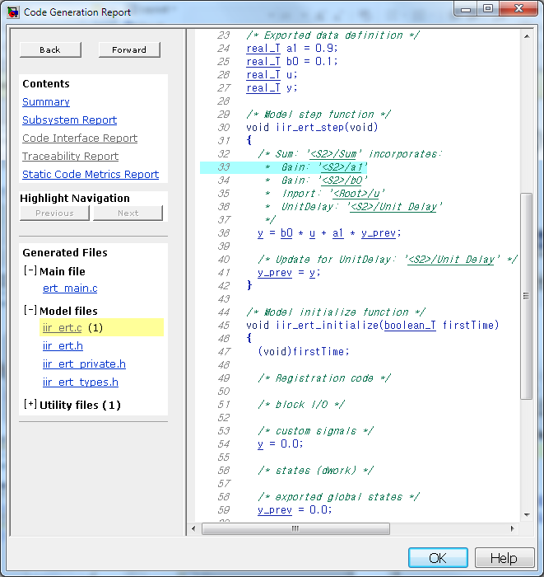
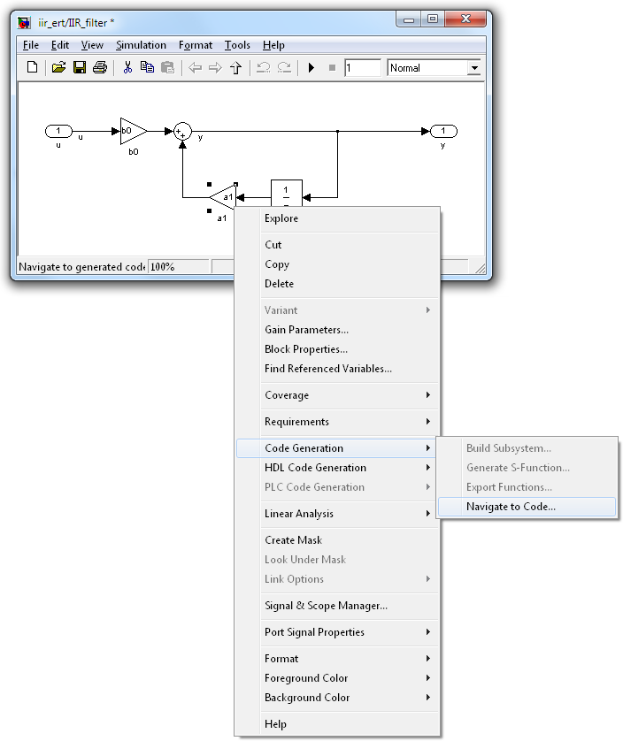
Example of HTML Report
Hyperlink within
C code files.
Hyperlink back
to model.
Hyperlink from model to code.

Slide 35
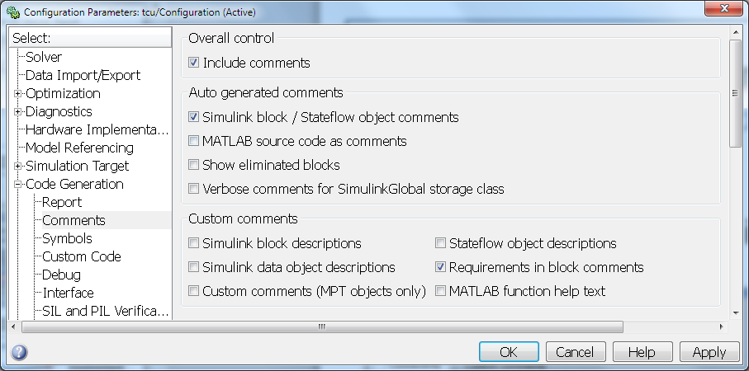
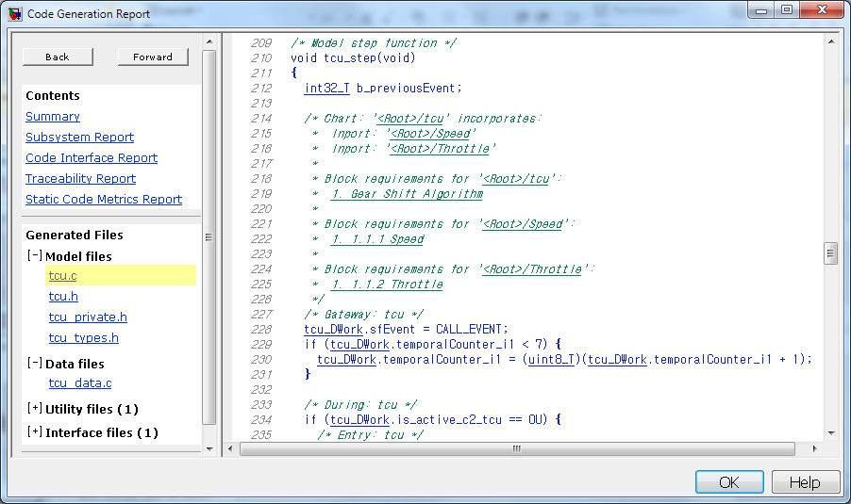
Tracing Requirements⬄Source Code Simulink Verification and Validation Embedded Coder
Including requirements in the generated source code
Notes:
Suggestion for the presenter: Highlight the key features mentioned on the slide and then talk about the benefits of requirements linking – why is this important for the customer.
Typically requirements are scattered around in different documents, whether it is a managed environment, or not. Simulink and Stateflow models are used in conjunction with these predominantly textual documents to describe the details of the design. This situation raises many challenges – models and textual documents can get out of sync, it is difficult to navigate to the right requirement, especially if there are multiple versions of it – whether it is to review the latest revision, or to write a requirement.
To address these problems Simulink Verification and Validation provides an infrastructure that allows you to link a particular document paragraph to any block, state, or transition in the model. Typically this capability is used to assign high level requirements to subsystems, or low level requirements to specific implementation details, or even component tests in Simulink.
The supported format for textual documents are… (list)
The requirements linking capability has several features that can help you review traceability between the model and the text and if RTW-EC is used for code generation, linked textual information can be propagated to the generated code in form of code comments.

Slide 36
Simulink Projects

Slide 37



Model-Based Design workflow
System Model
Controller
Model
Plant
Model
C & HDL
Mathematical
Model
Embedded System
Controller
Implementation
Plant
Hardware
Notes:
If you have been to any of our other seminars, you would have seen MathWorks discuss how Model-Based Design can be applied the development of such a controller. Also, a typical Model-Based Design workflow consists of developing the controller leveraging a model of the plant. In this case, our task is to develop the motor controller leveraging design with simulation and generating the controller implementation which could be c-code or HDL.
As previously mentioned, a complex design such as this will require a team of different disciplines. In this case there will be an engineer whose job is to design the motor. Another engineer whose job is to design the controller by working with the motor engineer to understand the characteristics of the motor. An engineer whose job is to implement the controller via C or HDL and work closely with the controls engineer to ensure any implementation constraints don’t negatively impact the original design. Each of these three engineers must be able to efficiently work together often times in parallel.

Slide 38
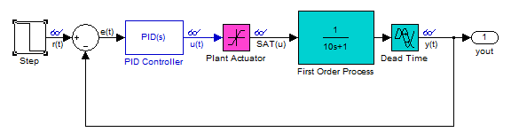
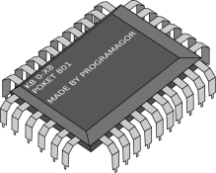
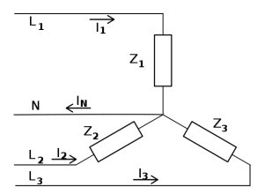
Complex designs require multiple disciplines
C & HDL
Notes:
These three engineers have the same end goal which is to deliver a spindle motor drive system, but they each focus on a different aspect of the design.
We have a motor engineer (green) who is tasked with the development of the physical motor. A motor engineer typically thinks about the physical characteristics of the motor and typically does motor design simulation using an FEA based tool.
The controls engineer is tasked with the development of the controls of the motor. The controls engineer will be thinking about algorithms which can be used to drive the motor and the system performance. It is common to develop these controls algorithms in Simulink and analyze system performance through simulation.
The software engineer will focus on implementing the controls algorithms on the physical hardware through C-code or potentially HDL. They will be very familiar with the C language and will have concerns of the complexity of the algorithm and the required processor resources to implement these algorithms.

Slide 39
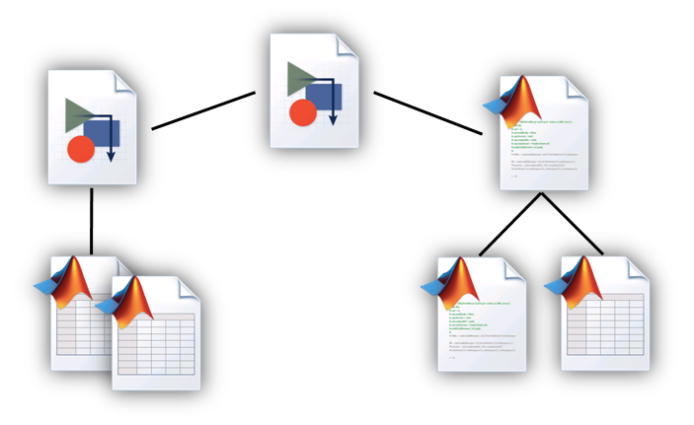
Considerations for reproducing the project across the design team
Project file management
Version control
Project initialization and termination
Share · Standardize · Iterate

Slide 40
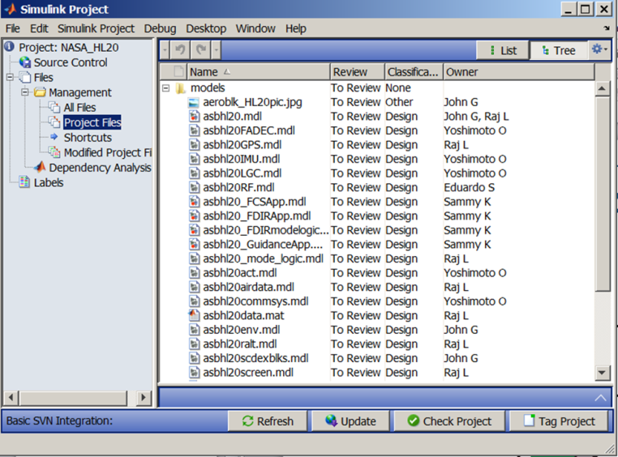








Organize, Manage
Compare changes
HDL

Slide 41

Source Control Integration
Integrate with 3rd party revision
control tools
Basic revision control
Lightweight local version control tool for single user
Basic integration with Subversion (SVN) and Git
Adaptor SDK free download available for integration between Simulink Projects and 3rd revision control tools
Developed
with SDK
Local Version Control
Subversion/Git
Other Version Control Tools

Slide 42
Software Engineering

Slide 43
Modeling Complex Software Systems
Algorithmic Complexity
Simulink
Stateflow
Embedded MATLAB
UML and Simulink
Hybrid
UML
Vendors
IBM Rhapsody
ARTiSAN Studio
IBM Rational System Designer
No Magic Magic Draw
Hand Code
Architectural Complexity
Notes:
UML is becoming popular where the architectural complexity of the system is high but does not help designers deal with high algorithmic complexity.
In our market, the UML tools being considered by our customers for such a hybrid solution are (in alphabetical order):
ARTiSAN Studio
IBM Rational System Designer
Kennedy-Carter iUML
IBM Telelogic Rhapsody
An approach that is beginning to be explored for the design of larger systems with a complex architecture and high algorithmic complexity is to use a hybrid of UML and Simulink
In a hybrid solution UML is often introduced in order to:
Describe the deployment of software components on a distributed deployment platform
Define reusable components, often using object-oriented techniques
Define the services offered by a software platform, such as middleware
Assemble components from different application domains, for example, graphical user interfaces and control algorithms
Hybrid development poses logistical challenges, not least in the need for expertise in and integration between two different technologies and tool chains. So it may be that where the case for hybrid development can be made but not strongly, a compromise approach using just the Simulink toolset may be the most effective option. It is worth reviewing the features of Simulink that support component-based modeling to determine whether they are sufficient to meet your software development needs.

Slide 44
Projects with Low Algorithm Complexity and High Architectural Complexity
Algorithmic Complexity
Architectural Complexity
Architecture Modeling
UML
Classes
Sequence
Diagrams
State
Machines
Parse Algorithm Interface
Use
Cases
Composite
Structure
Diagrams
Algorithm Code
UML Coder
Non-Algorithmic & Interface Code
Example applications:
User interfaces
Data management
+
+ means IDE links the code together
Drivers
IDE Tool Chain
Notes:
Where algorithmic complexity is low (or perhaps the algorithms are pre-existing in code form) Simulink may not be required.
Nonetheless, if there are architectural challenges, a UML tool may be useful.
In this approach, drivers and (existing) algorithmic code are maintained in the Integrated Development Environment (IDE)
The software architecture and interfaces, and must of the non-algorithmic code are designed and maintained in the UML tool.
In order to provide a complete picture of the software architecture, the interface to legacy code can (depending on tool and programming language) be parsed into the UML tool. Code can be generated from the UML tool for those parts of the system for which it is responsible – often this code is mostly just a framework into which code is added in the IDE but sometimes functional behavior is added in the UML design and code generated from that, The most common example of this is the use of UML state charts to describe event-based behavior.

Slide 45
Projects with High Algorithm Complexity and Low/Moderate Architectural Complexity
Algorithmic Complexity
Architectural Complexity
Algorithm Modeling
Simulink
Embedded Coder
Stateflow
Blocksets
MATLAB
Algorithm Code
Legacy Code/ S-Function Import
Non-Algorithmic & Interface Code
+
Example applications:
Controllers (avionics, powertrain)
Signal processing
+ means IDE links the code together
Drivers
IDE Tool Chain
Notes:
Where the architectural requirements of a software system are not high, then a Simulink-based software architecture may suffice.
Where Simulink is used it generally maintains the lion’s share of the algorithmic code but there is often legacy algorithmic code that can be integrated into the Simulink design using the legacy code tool, or directly as one or more S-Functions.
In these types of system the non-algorithmic code and interface logic is often fairly straightforward and so can be coded directly in the IDE.

Slide 46
Projects with High Algorithmic and Architectural Complexity
Algorithmic Complexity
Architectural Complexity
Algorithm Modeling
Architecture Modeling
Simulink
Embedded Coder
Stateflow
Blocksets
UML
Classes
Sequence
Diagrams
MATLAB
Parse Algorithm Interface
Use
Cases
Composite
Structure
Diagrams
Algorithm Code
Legacy Code/ S-Function Import
Example applications:
Command, Control, Communications, Computers and Intelligence
Tracking systems
UML Coder
Non-Algorithmic & Interface Code
+
+ means IDE links the code together
Drivers
IDE Tool Chain
Notes:
Hybrid development involving combined use of UML tools and Simulink may be required if both algorithmic and architectural complexity are high. In this case, typically the algorithmic code is generated from Simulink and the non-algorithmic and interface code is generated from the UML tool.
Existing legacy algorithmic code may need to be reused in the design of a Simulink algorithm. In this case, that code can be wrapped in an S-Function.
It can help to treat algorithmic code as a component in the overall software architecture captured in the UML tool. In that case the parsing capabilities offered by some UML tools can be used to capturing the interface to algorithmic components. This workflow is explored in more detail later.

Slide 47
Integration Approaches (Manual)
UML Tool
If Simulink model changes, regenerate Embedded Coder code and tweak handcrafted classes.
Simulink and Stateflow
Handcraft classes corresponding to C++ header files
C++ Generator
Embedded Coder
C++ code from UML tool
Code from Embedded Coder with C++ option
C++
C++
Best Practice
Define fewer and larger Simulink “classes”
Minimize the frequency of code handover
Perform verification early and often
Code Integration Environment
Compile and link code files from both sources
Notes:
This slide and the slide following focus on the design flows required to support hybrid UML/Simulink development. The first describes a manual approach to integration, the second an automated approach. (Note that although C++ is suggested as the interchange medium, C can also be used.)
The design flow starts with Simulink; code is generated from a Simulink model using RTW/EC.
An engineer analyses this code and constructs a class that precisely describes the header file generated from RTW/EC. Once this is done, this class becomes part of the architecture of the software system and may be referenced by other classes within the software.
Code is then generated from the UML model. This code represents both non-algorithmic classes and other glue code used to facilitate communication between software components. As long as algorithmic components (those described in Simulink) are accurately represented in the UML model, the code generated from the UML model will call the RTW/EC generated code correctly and any required pre-processor directives (like #includes) will be correctly established. This in turn should minimise integration problems during compile and build in the IDE.
In any approach where two tools are being used together there is bound to be overhead imposed by the more complex design flow. To minimise this overhead it is recommended to keep the number of inter-tool transactions as small as possible. Creating larger components in Simulink, perhaps by composing several models together, and performing as much verification as possible in Simulink, thus reducing unnecessary design iterations, can help significantly.

Slide 48
Integration Approaches (Automated)
Parse C++ header files into UML classes
UML Tool
Simulink and Stateflow
If Simulink model changes, regenerate the code and re-parse.
C++ Generator
Embedded Coder
C++ code from UML tool
Code from Embedded Coder with C++ option
Parse Code
C++
C++
Code Integration Environment
Compile and link code files from both sources
http://www.mathworks.com/videos/hybrid-software-development-with-simulink-and-uml-tools-68870.html?type=shadow
Notes:
Many UML tools do have useful C++ parsing technologies that can be used to read in the code generated from Simulink.
These parsers enable an automated approach where the header files generated from RTW/EC can be automatically imported as classes in the UML model, and when the header files change these classes can be automatically updated. This reduces the incidence of errors due to mistakes in rendering UML classes from header files by hand.
Although this doesn’t tend to work as well for C we do have several customers using an automated C based approach.

Slide 49
Demo for Automated Integration Approaches

Slide 50






S/W
Requirements
Simulink and Stateflow
Simulink and Stateflow
UML Tool
Create ‘placeholder’ model
Simulink and Stateflow
Create software architecture
Real-Time Workshop Embedded Coder
Parse Code
C++
Generate code from Real-Time Workshop Embedded Coder with C++ option
Notes:
Many UML tools do have useful C++ parsing technologies that can be used to read in the code generated from Simulink.
These parsers enable an automated approach where the header files generated from RTW/EC can be automatically imported as classes in the UML model, and when the header files change these classes can be automatically updated. This reduces the incidence of errors due to mistakes in rendering UML classes from header files by hand.
Although this doesn’t tend to work as well for C we do have several customers using an automated C based approach.

Slide 51
Setting Up A Hybrid Development Project
S/W
Requirements
Simulink and Stateflow
Simulink and Stateflow
UML Tool
Create ‘placeholder’ model
Simulink and Stateflow
Embedded Coder
Inserting a Simulink Component into a Software Architecture.
Notes:
Many UML tools do have useful C++ parsing technologies that can be used to read in the code generated from Simulink.
These parsers enable an automated approach where the header files generated from RTW/EC can be automatically imported as classes in the UML model, and when the header files change these classes can be automatically updated. This reduces the incidence of errors due to mistakes in rendering UML classes from header files by hand.
Although this doesn’t tend to work as well for C we do have several customers using an automated C based approach.

Slide 52
Create a Simulink Component by defining the interfaces – 1 Input and 2 Output
S/W
Requirements
Create ‘placeholder’ model
Simulink and Stateflow
Simulink and Stateflow
UML Tool
Simulink and Stateflow
Embedded Coder
Notes:
Many UML tools do have useful C++ parsing technologies that can be used to read in the code generated from Simulink.
These parsers enable an automated approach where the header files generated from RTW/EC can be automatically imported as classes in the UML model, and when the header files change these classes can be automatically updated. This reduces the incidence of errors due to mistakes in rendering UML classes from header files by hand.
Although this doesn’t tend to work as well for C we do have several customers using an automated C based approach.

Slide 53

S/W
Requirements
Simulink and Stateflow
Simulink and Stateflow
UML Tool
Create ‘placeholder’ model
Simulink and Stateflow
Embedded Coder
Notes:
Many UML tools do have useful C++ parsing technologies that can be used to read in the code generated from Simulink.
These parsers enable an automated approach where the header files generated from RTW/EC can be automatically imported as classes in the UML model, and when the header files change these classes can be automatically updated. This reduces the incidence of errors due to mistakes in rendering UML classes from header files by hand.
Although this doesn’t tend to work as well for C we do have several customers using an automated C based approach.

Slide 54
Generate C++ from Simulink component
S/W
Requirements
Simulink and Stateflow
Simulink and Stateflow
UML Tool
Create ‘placeholder’ model
Simulink and Stateflow
Embedded Coder
C++
Notes:
Many UML tools do have useful C++ parsing technologies that can be used to read in the code generated from Simulink.
These parsers enable an automated approach where the header files generated from RTW/EC can be automatically imported as classes in the UML model, and when the header files change these classes can be automatically updated. This reduces the incidence of errors due to mistakes in rendering UML classes from header files by hand.
Although this doesn’t tend to work as well for C we do have several customers using an automated C based approach.

Slide 55

S/W
Requirements
Simulink and Stateflow
Simulink and Stateflow
UML Tool
Create ‘placeholder’ model
Simulink and Stateflow
Embedded Coder
C++
Notes:
Many UML tools do have useful C++ parsing technologies that can be used to read in the code generated from Simulink.
These parsers enable an automated approach where the header files generated from RTW/EC can be automatically imported as classes in the UML model, and when the header files change these classes can be automatically updated. This reduces the incidence of errors due to mistakes in rendering UML classes from header files by hand.
Although this doesn’t tend to work as well for C we do have several customers using an automated C based approach.

Slide 56
S/W
Requirements
Simulink and Stateflow
Simulink and Stateflow
UML Tool
Create ‘placeholder’ model
Simulink and Stateflow
Embedded Coder
Parse Code
C++
Notes:
Many UML tools do have useful C++ parsing technologies that can be used to read in the code generated from Simulink.
These parsers enable an automated approach where the header files generated from RTW/EC can be automatically imported as classes in the UML model, and when the header files change these classes can be automatically updated. This reduces the incidence of errors due to mistakes in rendering UML classes from header files by hand.
Although this doesn’t tend to work as well for C we do have several customers using an automated C based approach.

Slide 57

S/W
Requirements
Simulink and Stateflow
Simulink and Stateflow
UML Tool
Create ‘placeholder’ model
Simulink and Stateflow
Embedded Coder
Parse Code
C++
Notes:
Many UML tools do have useful C++ parsing technologies that can be used to read in the code generated from Simulink.
These parsers enable an automated approach where the header files generated from RTW/EC can be automatically imported as classes in the UML model, and when the header files change these classes can be automatically updated. This reduces the incidence of errors due to mistakes in rendering UML classes from header files by hand.
Although this doesn’t tend to work as well for C we do have several customers using an automated C based approach.

Slide 58
S/W
Requirements
Simulink and Stateflow
Simulink and Stateflow
UML Tool
Create ‘placeholder’ model
Simulink and Stateflow
Create software architecture
Embedded Coder
Parse Code
C++
Notes:
Many UML tools do have useful C++ parsing technologies that can be used to read in the code generated from Simulink.
These parsers enable an automated approach where the header files generated from RTW/EC can be automatically imported as classes in the UML model, and when the header files change these classes can be automatically updated. This reduces the incidence of errors due to mistakes in rendering UML classes from header files by hand.
Although this doesn’t tend to work as well for C we do have several customers using an automated C based approach.

Slide 59

S/W
Requirements
Simulink and Stateflow
Simulink and Stateflow
UML Tool
Create ‘placeholder’ model
Simulink and Stateflow
Embedded Coder
Create software architecture
Parse Code
C++
Notes:
Many UML tools do have useful C++ parsing technologies that can be used to read in the code generated from Simulink.
These parsers enable an automated approach where the header files generated from RTW/EC can be automatically imported as classes in the UML model, and when the header files change these classes can be automatically updated. This reduces the incidence of errors due to mistakes in rendering UML classes from header files by hand.
Although this doesn’t tend to work as well for C we do have several customers using an automated C based approach.

Slide 60

Develop and test component in Simulink
S/W
Requirements
Simulink and Stateflow
Simulink and Stateflow
Simulink and Stateflow
Notes:
Many UML tools do have useful C++ parsing technologies that can be used to read in the code generated from Simulink.
These parsers enable an automated approach where the header files generated from RTW/EC can be automatically imported as classes in the UML model, and when the header files change these classes can be automatically updated. This reduces the incidence of errors due to mistakes in rendering UML classes from header files by hand.
Although this doesn’t tend to work as well for C we do have several customers using an automated C based approach.

Slide 61

Generate code
S/W
Requirements
Simulink and Stateflow
Simulink and Stateflow
Simulink and Stateflow
Notes:
Many UML tools do have useful C++ parsing technologies that can be used to read in the code generated from Simulink.
These parsers enable an automated approach where the header files generated from RTW/EC can be automatically imported as classes in the UML model, and when the header files change these classes can be automatically updated. This reduces the incidence of errors due to mistakes in rendering UML classes from header files by hand.
Although this doesn’t tend to work as well for C we do have several customers using an automated C based approach.

Slide 62
S/W
Requirements
Simulink and Stateflow
Simulink and Stateflow
UML Tool
Create ‘placeholder’ model
Simulink and Stateflow
Embedded Coder
Re - Parse Code
C++
Notes:
Many UML tools do have useful C++ parsing technologies that can be used to read in the code generated from Simulink.
These parsers enable an automated approach where the header files generated from RTW/EC can be automatically imported as classes in the UML model, and when the header files change these classes can be automatically updated. This reduces the incidence of errors due to mistakes in rendering UML classes from header files by hand.
Although this doesn’t tend to work as well for C we do have several customers using an automated C based approach.

Slide 63

S/W
Requirements
Simulink and Stateflow
Simulink and Stateflow
UML Tool
Create ‘placeholder’ model
Simulink and Stateflow
Embedded Coder
Re - Parse Code
C++
Notes:
Many UML tools do have useful C++ parsing technologies that can be used to read in the code generated from Simulink.
These parsers enable an automated approach where the header files generated from RTW/EC can be automatically imported as classes in the UML model, and when the header files change these classes can be automatically updated. This reduces the incidence of errors due to mistakes in rendering UML classes from header files by hand.
Although this doesn’t tend to work as well for C we do have several customers using an automated C based approach.

Slide 64
System Engineering

Slide 65
From Requirements to Architecture and Specification
Requirements
Architecture
Behavior
Abstract Detailed

Slide 66
What is modeled?
System
Architecture
System
Behavior
Software System
Software Architecture
Software
Behavior
Abstract Detailed

Slide 67
How it is modeled using SysML/UML
Tools
Rhapsody (IBM)
Magic Draw (No Magic)
Enterprise Architect (Sparx)
CORE (ViTech)
SysML
System
Architecture
System
Behavior
Software System
UML
Software Architecture
Software
Behavior
Abstract Detailed

Slide 68
Hybrid Simulink-SysML/UML Workflow
SysML
Simulink
System
Architecture
System
Behavior
Software System
Simulink
Software Architecture
Software
Behavior
UML
Abstract Detailed

Slide 69


Hybrid Simulink- UML Workflow
Simulink
Software Architecture
Software
Behavior
UML
Software
Abstract Detailed
http://www.mathworks.com/videos/hybrid-software-development-with-simulink-and-uml-tools-68870.html?type=shadow

Slide 70
Hybrid Simulink-SysML/UML Workflow
SysML
Simulink
System
Architecture
System
Behavior
System
Abstract Detailed

Slide 71
Hybrid Simulink-SysML/UML Workflow #1
Import Architecture
SysML
Simulink
System
Architecture
System
Behavior
Abstract Detailed

Slide 72
Hybrid Simulink-SysML/UML Workflow #2
SysML
Simulink
System
Architecture
System
Behavior
Bi-Directional Trace via RMI (in Simulink V&V)
Abstract Detailed

Slide 73
Hybrid Simulink-SysML/UML Workflow #3
Consistency Check
SysML
Simulink
System
Architecture
System
Behavior
Abstract Detailed

Slide 74
Hybrid Simulink-SysML/UML Workflows
Import Architecture
Consistency Check
SysML
Simulink
System
Architecture
System
Behavior
Bi-Directional Trace via RMI (in Simulink V&V)
Abstract Detailed

Slide 75
Questions?
Notes:
[Timing: 15 minutes for Intro]

